Slide 1

A Study of SQL-on-Hadoop Systems
Yueguo Chen, Xiongpai Qin, Haoqiong Bian, Jun Chen, Zhaoan Dong
Xiaoyong Du, Yanjie Gao, Dehai Liu, Jiaheng Lu, Huijie Zhang
Renmin University of China

Slide 2
Outline
Motivation
Benchmarks for SQL-on-Hadoop systems
Experimental settings
Results
Observations

Slide 3
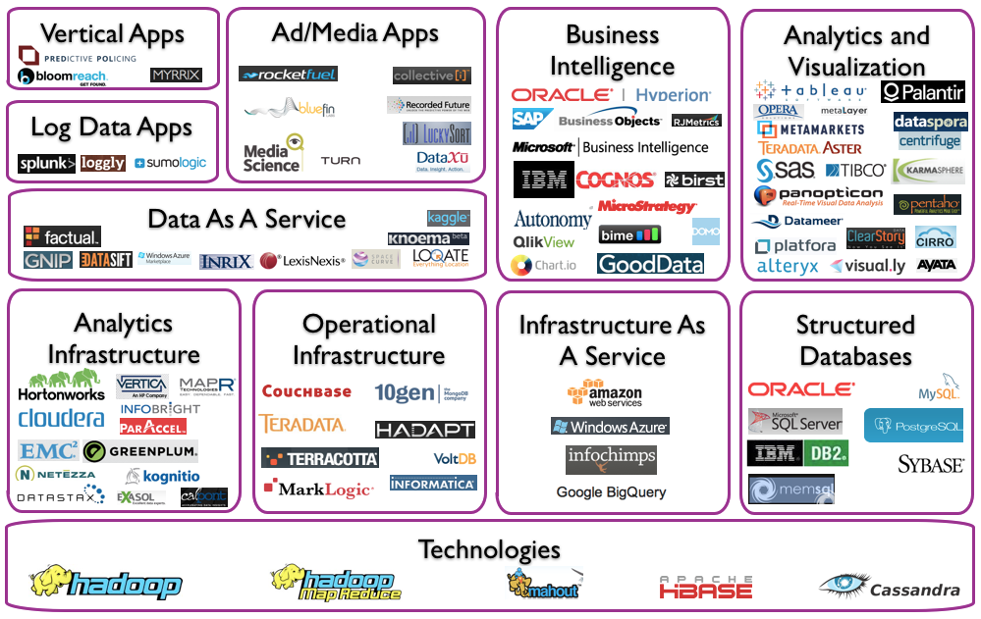

Slide 4
Trends of Big Data Analysis
Hadoop becomes the de facto standard for big data processing
Hive brings SQL analysis functions for big data (mostly structured) analysis
  Batch query (typically in hours)
Many efforts targeting on interactive query for big data
  Many techniques are borrowed from MPP analytical databases
  Dremel, Druid, Impala, Stinger/Tez, Drill…
  EMC Hawq, Teradata SQL-H, MS Polybase

Slide 5
Benchmark
  The market of big data analysis is quite similar to database markets in 80s
  New products come in flocks. No one dominates
Traditional databases benefits a lot from the benchmarks
  TPC: Transaction Processing Performance Council
The lack of benchmarks for big data
  Data variety, app variety, system complexity, workload dynamics

Slide 6
Benchmarks for Data Analysis
Big data benchmarks
  BigBench, Dynamic Analysis Pipeline
  BigDataBench by ICT, CAS
  Berkeley Big Data Benchmark
Benchmarks for BI
  TPC-H
  TPC-DS: scale up to 100TB
Performance tests for SQL-on-Hadoop systems

Slide 7
Performance Tests
Renda Xing Cloud (人大行云)
  50 physical nodes, up to 200 virtual nodes
  One typical virtual node: 4 cores, 20GB, 1TB
  Gigabit ethernet
Generate relational data using TPC-DS
  300GB、1TB、3TB
SQL-on-Hadoop systems
  Hive, Stinger, Shark
  Impala, Presto

Slide 8
Tested Systems
Apache Hive (0.10)
  Translate HiveQL into MR jobs
Hortonworks Stinger (Hive 0.12)
  Upgrade of Hive, query optimization, Hadoop , ORCFile
Berkeley Shark (0.7.0)
  In memory, columnar storage
  Avoid W/R intermediate results to disks
Cloudera Impala (1.0.1)
  Discard MR, apply basics of MPP analytical databases
  Parquet format, nested data, cache
Facebook Presto (0.54)
  Discard MR，in-memory processing and pipeline processing
  RCFile, cache, many similar to impala

Slide 9
Query Set
Single table:
  --qA5o--
  select ss_store_sk as store_sk, ss_sold_date_sk as date_sk
  ss_ext_sales_price as sales_price, ss_net_profit as profit
  from store_sales
  where ss_ext_sales_price>20
  order by profit
  limit 100;
  --qA9--
  select count(*) from store_sales
  where ss_quantity between 1 and 20
  limit 100;

Slide 10
Query Set
Ad hoc query: --qB65g—(join of two tables)
  select ss_store_sk,
  ss_item_sk,
  sum(ss_sales_price) as revenue
  from store_sales
  join date_dim on(store_sales.ss_sold_date_sk =date_dim.d_date_sk)
  where d_month_seq between 1176 and 1176+11
  group by ss_store_sk, ss_item_sk
  limit 100;

Slide 11
Query Set
  Star join: --qD27go--(5 tables)
  select i_item_id, s_state, avg(ss_quantity) agg1, avg(ss_list_price) agg2,
  avg(ss_coupon_amt) agg3, avg(ss_sales_price) agg4
  from store_sales ss
  join customer_demographics cd on(ss.ss_cdemo_sk = cd.cd_demo_sk)
  join date_dim dd on(ss.ss_sold_date_sk = dd.d_date_sk)
  join store s on(ss.ss_store_sk = s.s_store_sk)
  join item i on(ss.ss_item_sk = i.i_item_sk)
  where
  cd_gender = 'M' and
  cd_marital_status = 'S' and
  cd_education_status = 'College' and
  d_year = 2002 and s_state='TN'
  group by i_item_id, s_state
  order by i_item_id ,s_state
  limit 100 ;

Slide 12
Query Set
Complex query: --qD6gho—(5 tables)
  select a.ca_state state, count(*) cnt
  from customer_address a
  join customer c on(a.customer_address.ca_address_sk = c.c_current_addr_sk)
  join store_sales s on(c.c_customer_sk = s.ss_customer_sk)
  join date_dim d on(s.ss_sold_date_sk = d.d_date_sk)
  join item i on(s.ss_item_sk = i.i_item_sk)
  group by a.ca_state
  having count(*) >= 10
  order by cnt
  limit 100;

Slide 13
1TB data change the number of nodes
25, 50, 100

Slide 17
100 nodes increase data size from 1TB to 3TB

Slide 19
Observation
Columnar storage is important for performance improvement, when big table has many columns
  Stinger (Hive 0.12 with ORCFile) VS Hive, Impala Parquet VS Textfile
Discard MR model, performance benefits from saving the cost of intermediate results persistency
  Impala, Shark, Presto perform better than Hive and Stinger
  The superiority decreases when the queries become complex
Techniques from MPP databases do help:
  Impala performs much more better for join over two and more tables

Slide 20
Observation
Performance benefits more from the usage of large memory
  Shark and Impala perform better for small dataset
  Performance when memory is not enough, Shark has many problems
Data skewness significantly affects the performance
  Hive、Stinger、Shark are sensitive to data skewness
  It looks that the impact is not too much for Impala

Slide 21









Xiayong Du
Xiongpai Qin
Haoqiong Bian
Jun Chen
Huijie Zhang
Yanjie Gao
Long He
Dehai Liu
Zhaoan Dong

Slide 22
Thanks!
Q&A

